Slide 1
SOIL MOISTURE MONITORING USING AURDINO WITH OLED DISPLAY
ECA -4751 Principle of digital system and design for marine engineering
DEVADHARSHINI E -192524483 VANDHANA P -192525423
-
Guided by:
Dr. Judy Simon
Dr. Arockia Jayadas

Slide 2


INTRODUCTION
Soil moisture monitoring is essential in agriculture to ensure proper irrigation and water conservation.
Traditional irrigation methods often lead to overwatering or underwatering, affecting crop yield.
This project uses an Arduino microcontroller with a soil moisture sensor to measure soil water content.
An OLED display is used to show real-time moisture values clearly and efficiently.

Slide 3
LITERATURE REVIEW
Author / Year | Title | Technology Used | Findings
Smith et al., 2019 | Smart Irrigation System | Arduino + Moisture Sensor | Reduced water wastage by 30%
Kumar & Rao, 2020 | IoT-based Soil Monitoring | Arduino + WiFi | Enabled remote monitoring
Patel et al., 2021 | Precision Farming System | Sensors + OLED | Improved crop yield
Lee et al., 2022 | Automated Agriculture | Arduino + Sensors | Enhanced irrigation accuracy
Author / Year | Title | Technology Used | Findings

Slide 4
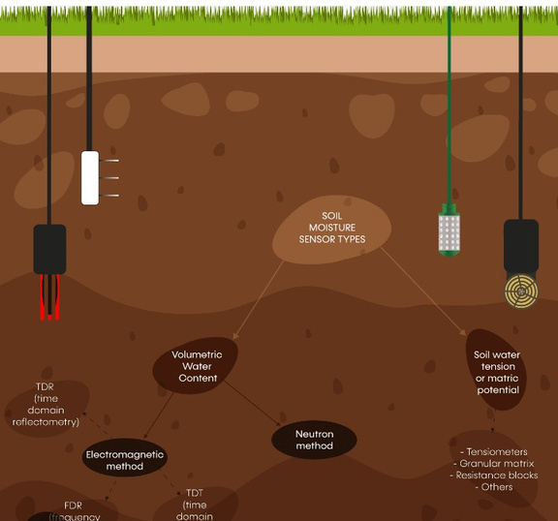
PROBLEM STATEMENT
Farmers and gardeners often irrigate crops without knowing whether the soil is dry, normal, or already wet.
This results in water wastage, poor crop growth, and increased power consumption.
There is no clear visual indication of soil condition in traditional methods.
Hence, a system is required to identify soil condition and display Dry, Normal, or Wet status clearly.

Slide 5
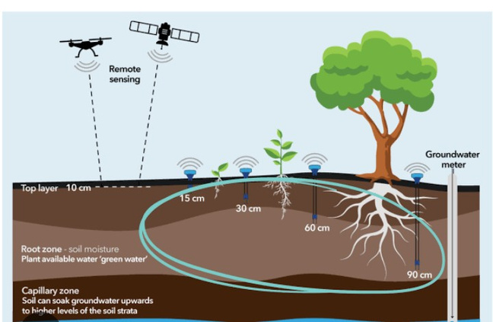
OBJECTIVES
To measure soil moisture level using a sensor
To display moisture percentage on an OLED display
To reduce water wastage through proper monitoring
To design a simple and low-cost system for farmers

Slide 6
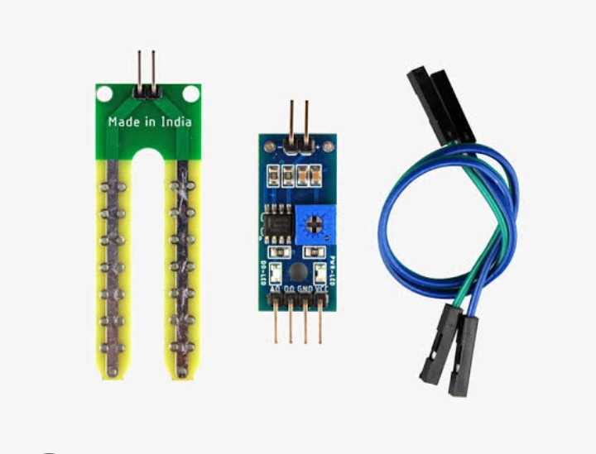
PROPOSED METHOD
The soil moisture sensor is inserted into the soil to measure water content.
The sensor output is connected to the Arduino analog input pin.
Arduino processes the sensor data and converts it into percentage form.
The moisture value is displayed on an OLED screen in real time.

Slide 7
MODULE
Module 1: Soil Moisture Sensing Module
This module senses the amount of water present in the soil.
Low moisture indicates Dry soil, medium indicates Normal, and high indicates Wet soil.
The sensor sends analog data to Arduino for processing.

Slide 8
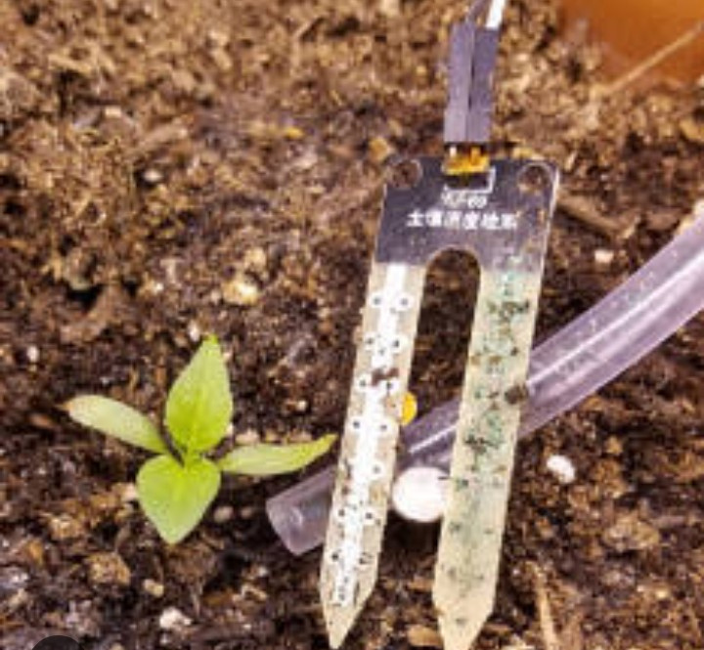
MODULE
Module 2: Processing and Display Module
Arduino processes sensor data and determines soil condition.
The OLED display shows moisture percentage along with Dry / Normal / Wet status.
This module provides real-time monitoring.

Slide 9
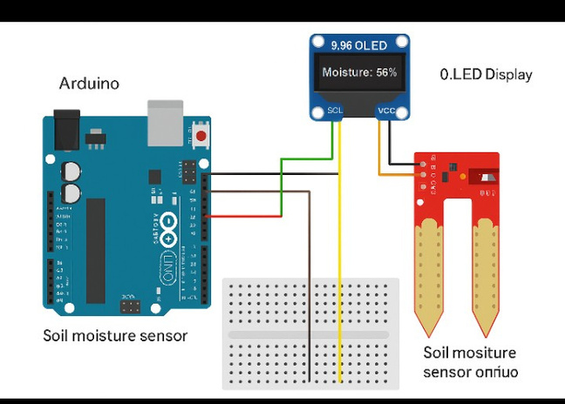
CIRCUIT EXPLANATION
The soil moisture sensor is connected to Arduino analog pin A0.
OLED display is connected using I2C communication (SDA and SCL).
Arduino continuously reads soil moisture data.
According to the value, soil condition is displayed as Dry, Normal, or Wet.

Slide 10
BLOCK DIAGRAM
Soil Moisture Sensor
↓
Arduino
(Moisture Analysis)
↓
OLED Display
(Dry / Normal / Wet)

Slide 11
LOGIC USED
Moisture % | Condition
0 – 30 % | DRY
31 – 70 % | NORMAL
71 – 100 % | WET

Slide 12
RESULT AND DISCUSSION
The system successfully detects soil moisture and classifies it into Dry, Normal, and Wet.
Dry soil shows low moisture percentage, while wet soil shows high percentage.
Normal condition indicates sufficient moisture for healthy plant growth.
This system helps avoid over-irrigation and under-irrigation.

Slide 13
FUTURE SCOPE
Automatic motor ON/OFF based on Dry/Wet status
IoT-based mobile monitoring
SMS alert when soil becomes dry
Solar powered irrigation system

Slide 14
CONCLUSION
This project effectively monitors soil moisture and classifies it as Dry, Normal, or Wet.
The OLED display provides clear real-time indication of soil condition.
The system is cost-effective, simple, and suitable for agricultural use.
It helps in saving water and improving crop productivity.

Slide 15
REFERENCES
Smith, J., Brown, A., & Wilson, R.,
“Smart Irrigation System Using Soil Moisture Sensors,”
IEEE International Conference on Smart Agriculture, 2019.
Kumar, S., & Rao, V.,
“IoT Based Soil Moisture Monitoring System for Precision Agriculture,”
International Journal of Advanced Research in Computer and Communication Engineering,
Vol. 9, Issue 5, 2020.
Patel, R., Shah, M., & Desai, K.,
“Precision Farming Using Soil Moisture Sensors and OLED Display,”
International Journal of Engineering Research & Technology (IJERT),
Vol. 10, Issue 3, 2021.
Lee, J., Kim, H., & Park, S.,
“Automated Agriculture System Based on Arduino and Sensor Networks,”
Sensors Journal (MDPI),
Vol. 22, No. 4, 2022.

